Slide 1
Data Partitioning
Tom Hanley
Data & Analytics Manager
Walt Disney Parks & Resorts
https://github.com/ThomasFHanley/OrlandoCodeCamp2017-04-08
thanley@htabs.com

Slide 2
Agenda
What is data partitioning?
Benefits and Use Cases
Types of Partitioning
Vertical Partitioning
Horizontal Partitioning
Views
Tables
Partition Elimination
Lock Escalation
Q&A
Notes:
Introductory… I’ll cover a lot of information about data partitioning, but most certainly not all
There is a difference between data partitioning and table partitioning. Table partitioning is a subset of data partitioning. With the advent of the cloud (Azure, AWS, Google Cloud, etc.) data partitioning takes on an even broader meaning. To be fair, the idea of partitioning data is not a new one. It has been done as long as data has been stored (paper copies distributed amongst regional branches, for example… putting things in separate filing cabinets or folders). But it is evolving and expanding at a growing rate.
Given this venue, my focus and all of my examples will be with SQL Server but this functionality and these concepts are most assuredly not limited to Microsoft’s RDBMS offering

Slide 3
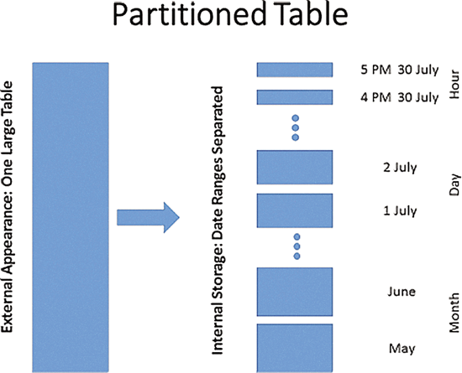
What is Data Partitioning?
“A partition is a division of a logical database or its constituent elements into distinct independent parts. Database partitioning is normally done for manageability, performance or availability reasons, or for load balancing.” – Wikipedia
Key components:
Segregating the data into “distinct independent parts”
Ideally being in a position to query just the data you need while maintaining availability to as MUCH of the data as possible
This tends to be a function of an RDBMS platform (e.g. SQL Server, Oracle, MySQL, Teradata, PostgreSQL)
Notes:
It sometimes goes by different names – Teradata calls it “Partitioned primary indexes”
For this conversation, we will be focusing on the use of data partitioning in Microsoft SQL Server

Slide 4
Benefits and Use Cases
Partitioning allows you to slide data in and out of tables
Partitioning can improve concurrency concerns
The “update” of the table is handled quicker
Partitioning can have an impact on lock escalation (escalating to a partition instead of the entire table)
Performance can (and ideally should) be impacted
Focus on only the data needed to satisfy the query
Partition elimination can even remove portions of a single table from the purview of the query
How your partitioning is structured, and how your queries are interrogating the table, matter immensely!

Slide 5
Benefits and Use Cases
Improve Scalability
Spread resources across hardware (servers, storage, etc.) to go beyond individual hardware limits
Improve Availability
Avoid a single point of failure and allow at least some of the data to be available at a given time
Improve Security
Separate sensitive and non-sensitive data into different partitions, and therefore into different servers or data stores
Provide operational flexibility
Fine tuning operations, maximize administrative efficiency, and minimize cost

Slide 6
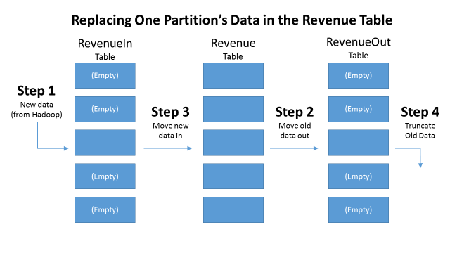
Benefits and Use Cases
Archiving old records / following a data retention policy
Allows us to remove days, months, years of data quickly without having to do an expensive delete
Introducing in new data
Loading in days, months, or even years of data
Could include batches of data
Updating whole tables
Turns out a table is one big partition!
Notes:
A lot of the loading and unloading tends to be time-based, but it could also be done based on batch jobs

Slide 7
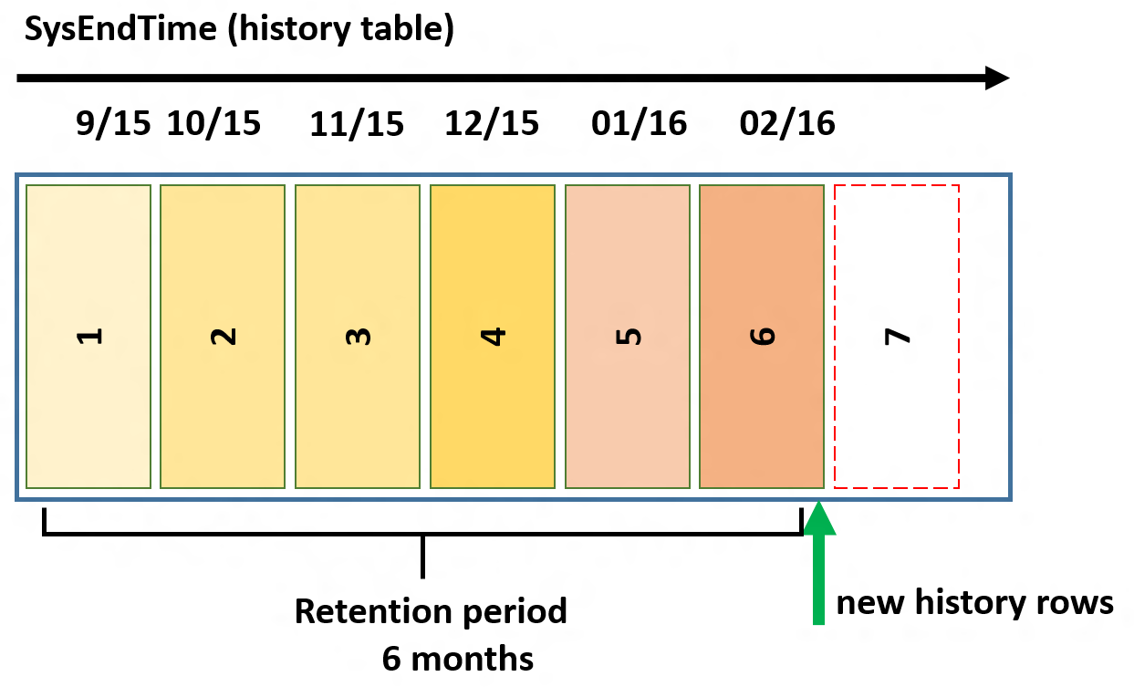
Benefits and Use Cases
Having datasets span various storage types or locations
Have older, less queried data on cheaper spinning media and more active data on more expensive SSDs
Separate out read-write from read-only data
Fine tune operations (flexibility)
Define different strategies for management, monitoring, backup and restore, etc. based on the data (different backup cadence)
Notes:
A lot of the loading and unloading tends to be time-based, but it could also be done based on batch IDs or some other discriminatory means

Slide 8
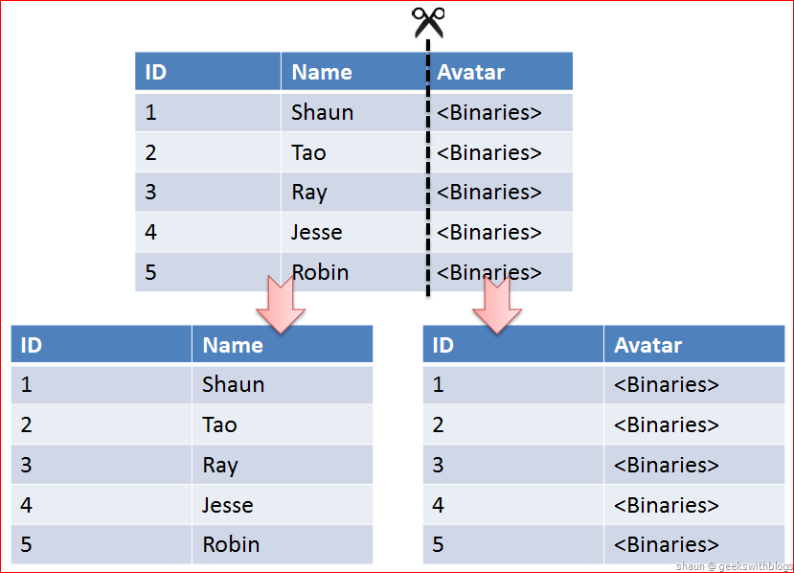
Types of data partitioning
Vertical Partitioning
1 table is split up into multiple physical tables by separating fields/columns of the data
Tables can then be queried separately, depending on the need, or via a view/query that joins them together
The optimizer can then drop some of the data (hopefully the heavier data) from the scope of the query
This process can also be used to separate out bits of data into separate hardware environments (as the tables do not have to exist on the same filegroup or database)

Slide 9
DIY / Homework
Demo #1
Vertical Table partitioning
Notes:
Demo #1 (VerticalPartitioningExample)
Create Table

Slide 10
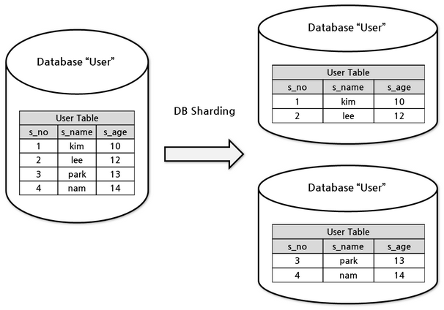
Types of data partitioning
Horizontal Partitioning (Sharding)
1 table is split up into multiple tables (partitioned view) or by groups of rows (partitions) by separating ranges of the data
Tables or partitions can then be queried separately and data can be archived or introduced in more granular and manageable “chunks”
The optimizer can then drop some of the data (ranges of the data) from the scope of the query (partition elimination)
This process can also be used to separate out bits of data into separate hardware environments (as the tables do not have to exist on the same filegroup or database)¹
Notes:
1 = Partition Switching requires that both partitions be on the same filegroup

Slide 11
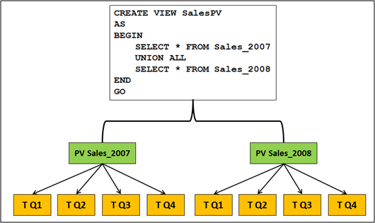
Horizontal Partitioned View
Poor person’s table partitioning
Until recently, table partitioning required SQL Server Enterprise Edition
Starting with SQL Server 2016 SP1 the Standard Edition supports all functionality most table partitioning functionality
Steps
Split data out into separate tables via a key/scheme
Create a view and UNION ALL the tables
Add constraints to help clue the optimizer into table elimination
Notes:
Starting with SQL Server 2016 SP1 the Standard Edition supports table partitioning (functionality) but will not leverage certain performance enhancements available on partitioning, like 'partitioned table parallelism'.

Slide 12
Demonstration
DEMO #2
HORIZONTAL Table partitioning (PARTITIONED VIEW)
Notes:
Demo #2 (PartitionedViewExample)

Slide 13
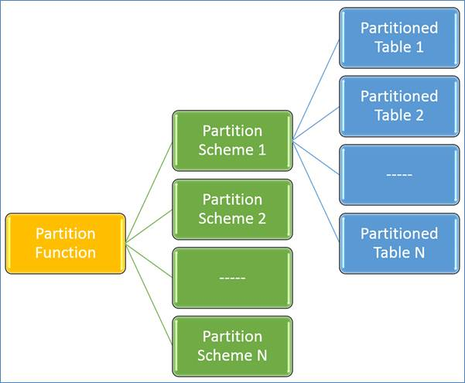
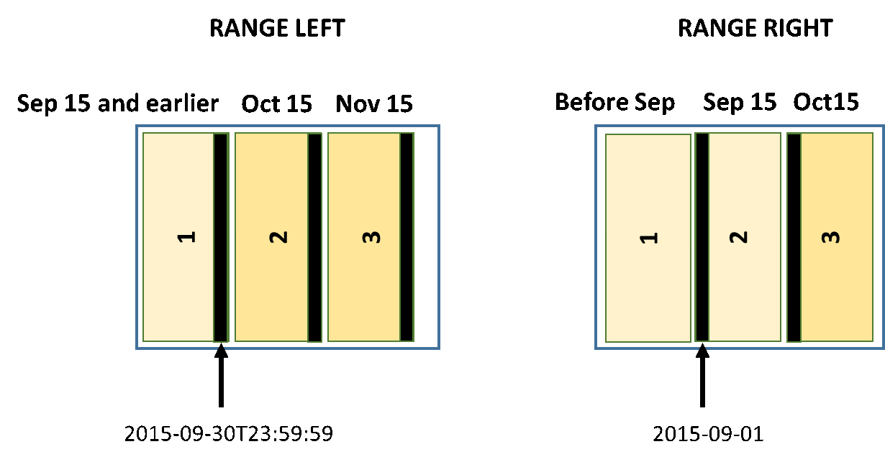
Horizontal Table Partitioning
Partitions are groups of rows
Data and indexes can be addressed in smaller chunks
Coming up with a partition key is very important!
No clustered index required (can be used on a heap)
Partition switching is fast since it is DDL (ALTER) not DML
Steps
Create partition function
Create filegroups
Create a partition scheme that maps filegroups
Create objects on the partition scheme
https://www.brentozar.com/archive/2013/01/sql-server-table-partitioning-tutorial-videos-and-scripts/
Notes:
Some debate between Partition Switching being DDL or DML… but given that data is not being moved I would argue it is largely DDL (especially since it uses the ALTER statement)

Slide 14
Demonstration
DEMO #3
HORIZONTAL Table partitioning (PARTITIONED TABLE)
Notes:
Demo #3 (Table Partitioning Tutorial)
Simply put, a PF is the logical definition of your boundary cases (or possibly better described as the intervals over which each partition covers). A PF must cover the entire domain from negative infinity to positive infinity. If a value doesn't have a place to go then you'd have a problem with the logic of your partition function.
In the case of RIGHT, this says that the value is a lower boundary of the second partition
A partitioned heap might be used in a data warehouse scenario where you want to slide data in and out but don’t want/need the overhead associated with a clustered index
LUN = Logical unit – used with SCSI or SAN storage
You can rebuild indexes for the entire table or by individual partitions!

Slide 15
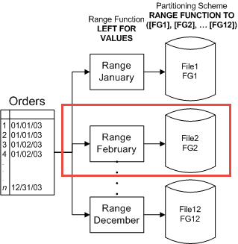
(Horizontal) Partition Elimination
What is Partition Elimination?
Partitions / ranges of data can be eliminated from the scope of a query
Imagine if the object you were querying was a fraction of its current size
This means smaller scans, seeks, join conditions, etc.
Important Points
Predicate/WHERE clause must be aligned with partition function
Basic rules of indexing apply (data types matter!)
Actual Partition Count shows how many partitions were interrogated
Notes:
Partitions are kind of like tables within a table
Go back to our example of a partitioned view or vertical partitioning and how we might hit a smaller table by itself (though it is more analogous to a partitioned view since we are still talking about horizontal partitioning)

Slide 16
DIY / Homework
DEMO #4
Partition elimination
Notes:
Demo #4 (PartitionEliminationExample)
Simply put, a PF is the logical definition of your boundary cases (or possibly better described as the intervals over which each partition covers). A PF must cover the entire domain from negative infinity to positive infinity. If a value doesn't have a place to go then you'd have a problem with the logic of your partition function.
In the case of RIGHT, this says that the value is a lower boundary of the second partition
A partitioned heap might be used in a data warehouse scenario where you want to slide data in and out but don’t want/need the overhead associated with a clustered index

Slide 17
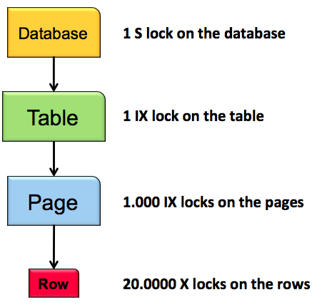
Lock Escalation (& Horizontal Partitioning)
Purpose and Impact
Locks serve to protect shared resources or objects
Locks help maintain/enforce the ACID guarantee
Various types of locks (over 20) including Shared locks (S), Exclusive locks (X), Intent locks (IS, IX), etc.
Steps
Explicit TRANsaction with update against Non-partitioned table
Try to do a select rows outside of the rows updated
Explicit TRANsaction with update against a Partitioned table
Try to do a select rows outside of the rows updated (against other/another partition)
Notes:
HoBT-level locks usually increase concurrency, but introduce the potential for deadlocks when transactions that are locking different partitions each want to expand their exclusive locks to the other partitions. In rare instances, TABLE locking granularity might perform better.
ACID – Atomicity, Consistency, Isolation, Durability

Slide 18
Demonstration
DEMO #5
Lock escalation
Notes:
Simply put, a PF is the logical definition of your boundary cases (or possibly better described as the intervals over which each partition covers). A PF must cover the entire domain from negative infinity to positive infinity. If a value doesn't have a place to go then you'd have a problem with the logic of your partition function.
In the case of RIGHT, this says that the value is a lower boundary of the second partition
A partitioned heap might be used in a data warehouse scenario where you want to slide data in and out but don’t want/need the overhead associated with a clustered index

Slide 19
Q&A
DATA PARTITIOning
https://github.com/ThomasFHanley/OrlandoCodeCamp2017-04-08
thanley@htabs.com

